Slide 1


From Nearby to DashPass
Kelly Peterson
Q1 2023

Slide 2




The “ideal” Cx experience (for churned or occasional Cx)
By increasing order frequency we can increase the perceived value of DashPass
Tries Nearby
Increase order frequency
Mx Shift
Signs up for DashPass

Slide 3


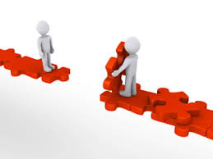
What’s happening today
Only a small segment of Cx are MxShifting
DashPass sign ups are down among Nearby Cx
The value gap between Classic and DashPass has narrowed

Slide 4
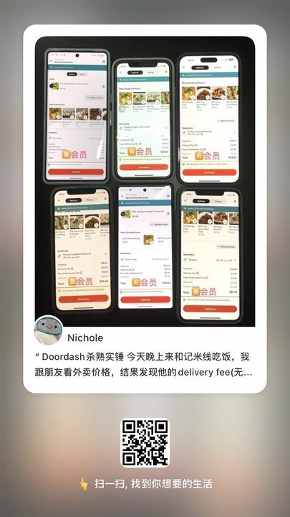
There is a disconnect between DoorDash having “reliably low cost” and DashPass exclusive savings
Posts in the app XiaoHongShu (a Chinese social media app used by many in the U.S are using it too)
People are comparing their delivery fee to their friends. Non-DP members are seeing lower delivery fees compares to the DP members on the same store.
Cx were surprised to find that the DP members always had the higher price at checkout. (Likely due to experiments we have live)

Slide 5
Research Motivation: Understand how Nearby Cx feel about DashPass and identify ways to increase their interest in subscribing
Tries Nearby
Increase order frequency
Mx Shift
Signs up for DashPass
How do Nearby Cx think about DashPass value?
What do Cx think of Nearby? How have they changed their perceptions of DoorDash as a result of Nearby?
EPIC 1 Reactions
Understanding PAD
Churned Occasional Cx
Nearby to DashPass Shift
PAD DashPass Value
DashPass branding
New Research

Slide 6
Nearby Experience
Tries Nearby
Increase order frequency
Mx Shift
Signs up for DashPass

Slide 7

Awareness of “Nearby” as a brand remains low among Cx
“
for my last order I’m not sure why I had zero dollar delivery I think it was one of those order between this time kind of thing”
“
I think I’ve ordered (with Nearby), it’s very appealing, it’s almost like the zero dollar delivery zeros out the cost I would have to pay to not walk so it’s worth it, so I think I would have ordered from this category previous, I just can’t remember”
Much of the confusion around Nearby comes from
Lack of reading/quick scrolling on the homepage
Multiple communications around the concept with carousels featuring “local” “in your neighborhood”

Slide 8



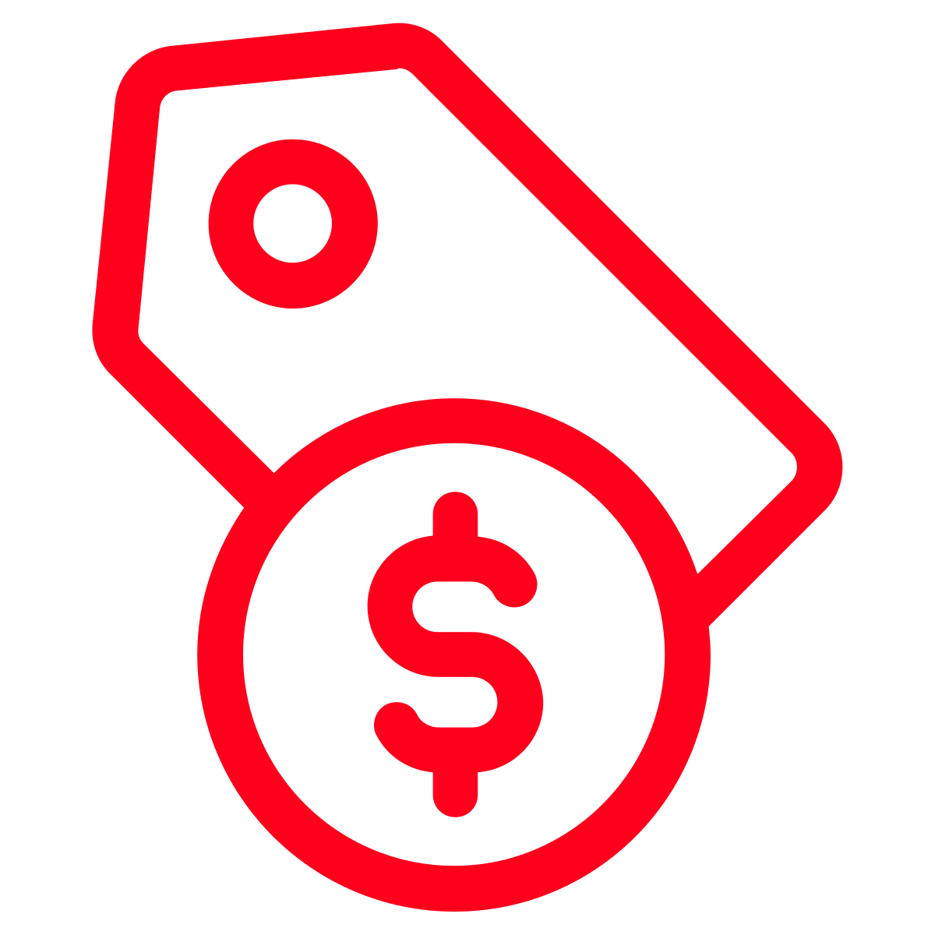
Cx rely heavily on their mood and cuisine preferences when ordering takeout, making it possible for them to miss Nearby carousels and communications
Typical order of consideration (on the homepage) when placing a food order:
1
Cuisine/Food item of interest
Cx indicated they were interested in Nearby because they felt it meant their meal would arrive faster in the initial concept tests and phase 1 of the experiment
2
Delivery fee
3
Delivery time
4
Price of menu items

Slide 9
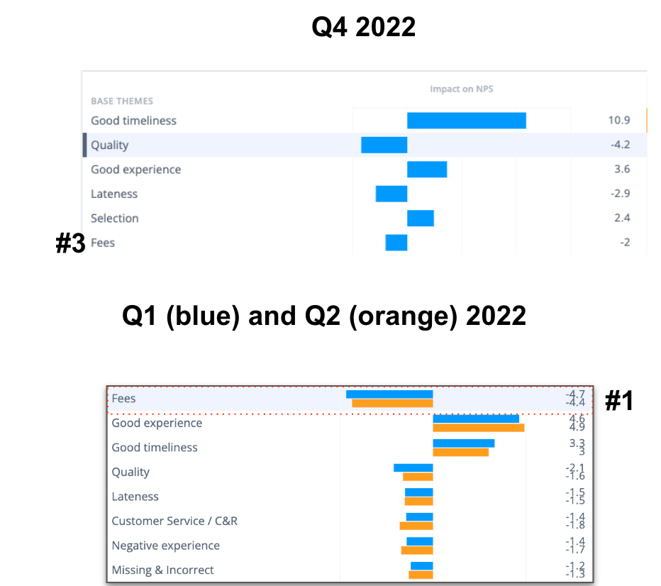
While DoorDash is perceived to be more affordable in recent months…
This Cx sentiment is consistent with what we see in NPS, where fees has dropped from the #1 driver of negative sentiment to the #3 driver for the first time in a long time
Three-quarters of Cx interviewed in the past month have expressed that they feel DoorDash is more affordable
This is primarily due to the fact that they feel they can find restaurants with delivery fees in their “acceptable range”
However, Cx still express concern over menu item inflation
Q4 2022 NPS

Slide 10
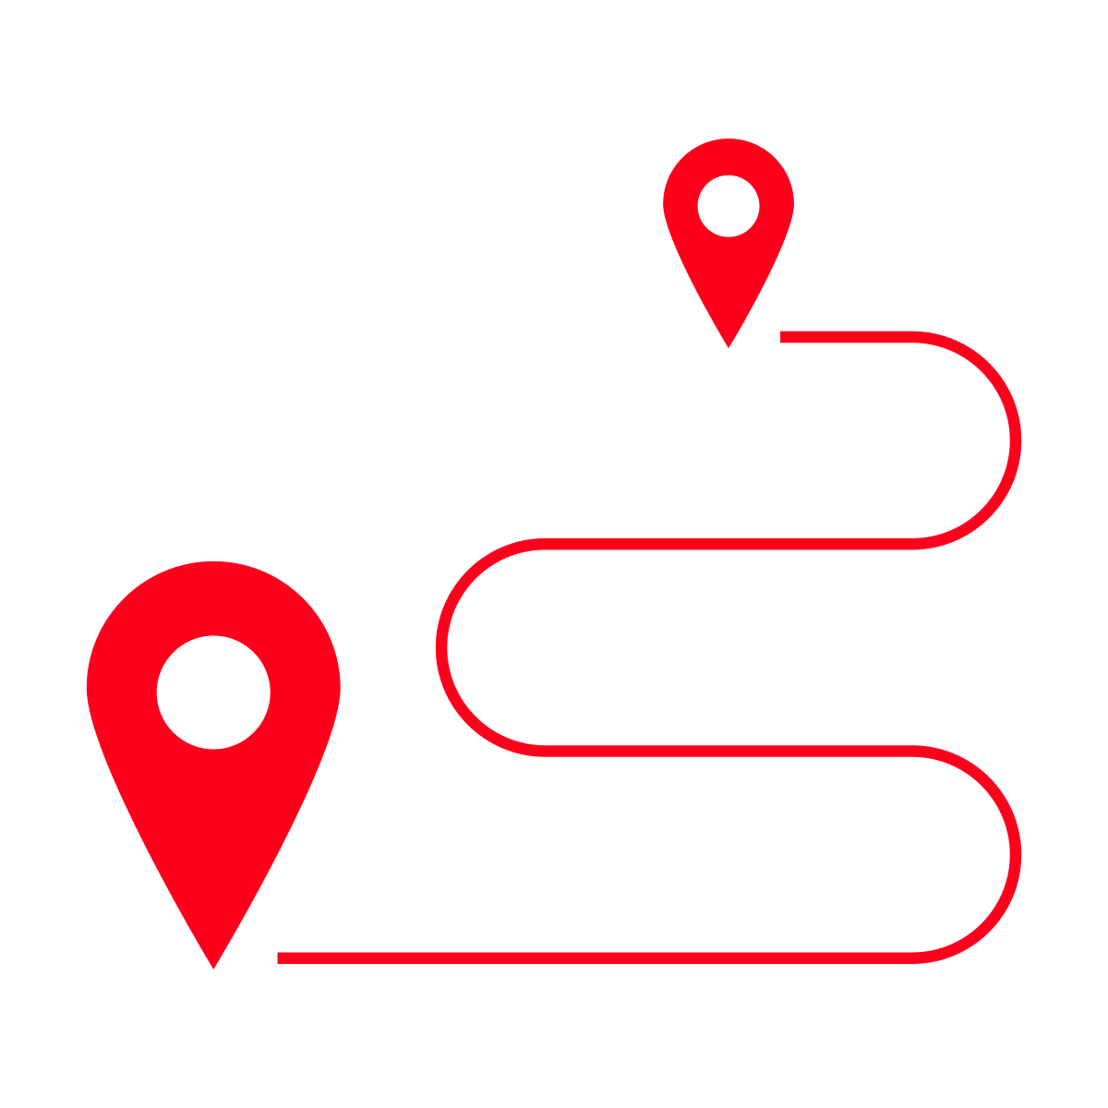
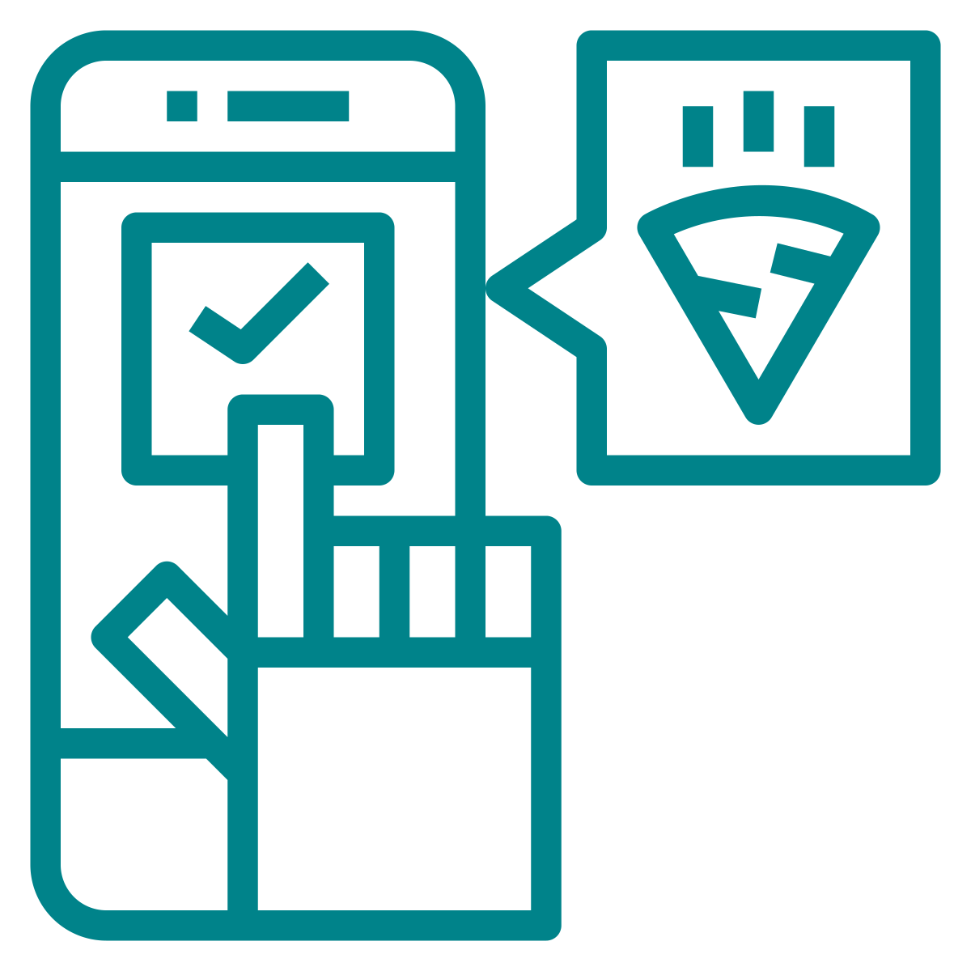
…Cx are not aware of any behavioral changes taken as a result of lower prices/fees
Cx who have MxShifted do not realize that they are swapping Nearby for non-Nearby Mx
Most Cx express that their order frequency has not changed
Because of low Nearby awareness, Cx are not looking for Nearby Rx when ordering
Instead they are focused on cuisine first, delivery fees second which sometimes will result in MxShift
Most Cx are comparing their order frequency to that during the pandemic; even there has been a recent increase it still feels less than 2020
Cx express multiple reasons for their order frequency including budget, lifestyle, family size and work arrangements

Slide 11

However, for some Cx increasing order frequency is not feasible
Approximately one-third of Cx interviewed indicated they order from DoorDash once a month or less often because of monetary hardship
“
Times are hard, money is a bit of a struggle at the moment, if I had spare funds it would be worth it”
For these Cx, ordering is a splurge rather than a budgeted moment

Slide 12
Insight summary…
Saving with “Nearby” is more of subconscious experience, Cx can not recall exactly why they are savings or any changes they have made because of it
Cx generally feel like DoorDash is going “in the right direction” in terms of affordability; it’s not perfect, but it’s getting better
However, there are some Cx that we cannot expect to increase frequency or sign up for DashPass, further sizing of this audience may be required
When ordering, Cx first look at cuisine/restaurant, then they look at fees. This may make communicating DashPass value more difficult depending on Cx Rx preferences and flexibility

Slide 13
DashPass Perceptions
Tries Nearby
Increase order frequency
Mx Shift
Signs up for DashPass

Slide 14
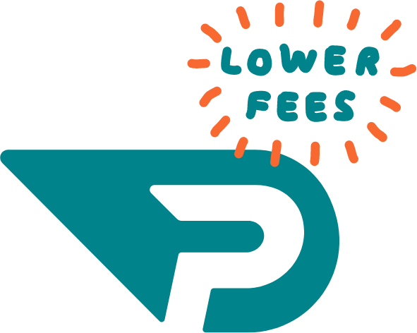
Most Cx do not know how much DashPass costs or how to describe it
“
I don’t know if I tried it, maybe I did a couple years ago…I assume it’s $10-$20 a month for free or lower cost delivery charges. I think that’s essentially what it is”
Half of Cx interviewed believed DashPass cost $20 a month
While some Cx expressed interest, most did not think they would get the value out of it
Many Cx were unsure of the benefits of DashPass, though most knew you received discounted or free delivery fees
This was true of Cx who had never tried DashPass, those that did a trial, and those that churned from DashPass

Slide 15
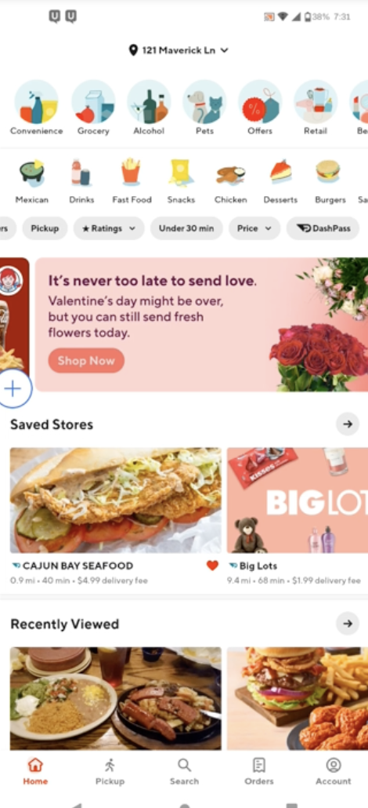
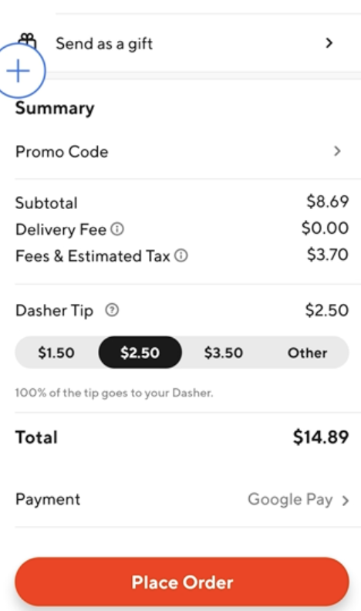
Classic Cx do not fully understand the benefits of DashPass as provided on the homepage and at checkout
As a Classic Cx, I see the DP logo, but there is also a delivery fee. I do not realize that the DP logo means that if I signed up for DP, the delivery fee would be removed.
Classic Cx who have never used DP are unsure what benefits they would get with a DP subscription when they’ve selected a $0 delivery fee Mx (Nearby,Happy Hour)
DashPass Branding Association Research Report

Slide 16
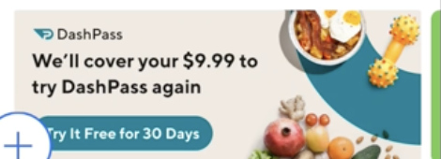
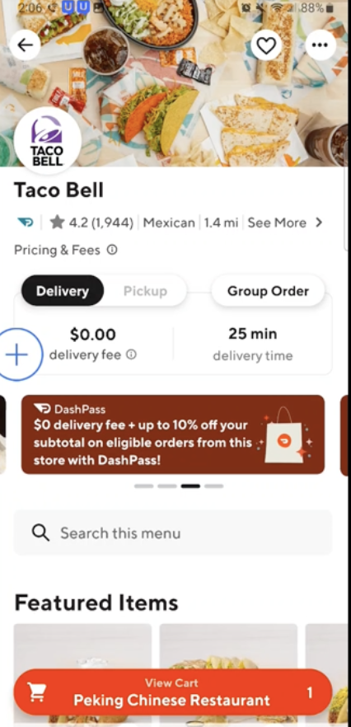
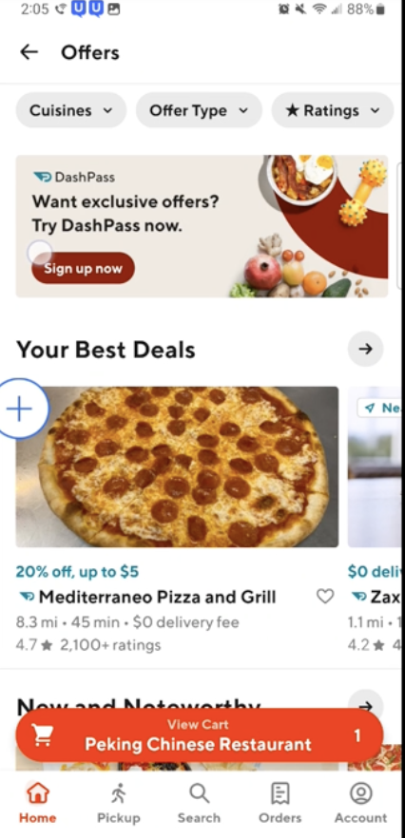
Classic Cx can identify various DashPass upsell banners that appear in various parts of the app (when they look for it)
Cx rely on the text ‘DashPass’ on the banners to know that these are for DashPass rather than on the color (no consistent color).
Classic Cx recall having seen DP upsell banners in app, but do not recall having tapped on them.
“Last time I logged in to order a few weeks ago, a big pop up showed up that said DashPass, from my memory it said you get 50% off your order, I remember seeing subscribing to DashPass and get 50% off your order, I didn’t use it at that time coz I was in a rush and didn’t look at the offer closely”. Classic Cx
DashPass Branding Association Research Report

Slide 17

Nearby Cx feel that once a week is the minimum requirement to recognize value from DashPass
However, there is some hesitation and they feel 2-3 times a week is the real threshold. Additionally some Cx indicated they need a longer trial period to understand the savings available to them.
Cx struggle with the “mental math” required to calculate value. They often state they need at least $15 in savings per month or $4-$5 saved per order. While this works out to about once a week for most Cx, it still doesn’t feel like enough.
“
If you could tell me I’d save $5 an order, or $20 in a month that would sell me on it”
- MxShift user who orders 1-2 times per week

Slide 18
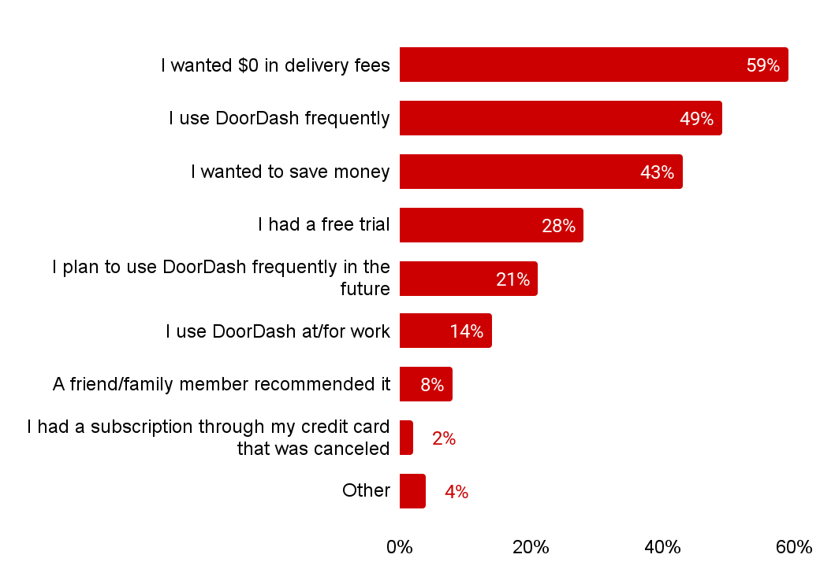
Frequency of DoorDash use is the #2 reason most existing DashPass Cx signed up in the first place
 | Power Cx | Habit Cx | Core Net Saver | Low Net Saver | Net Loser | Dormant Cx | Early Paid Subs | Trial Cx
 | 63% | 64% | 64% | 63% | 63% | 56% | 57% | 50%↓
 | 70%↑ | 57%↑ | 62%↑ | 50% | 44% | 40% | 42% | 30%↓
 | 45% | 50%↑ | 44% | 43% | 43% | 47% | 40% | 39%
 | 19% | 22% | 19% | 26% | 21% | 25% | 33% | 57%↑
 | 30%↑ | 27% | 21% | 21% | 21% | 17% | 18% | 19%
 | 16% | 15% | 14% | 18% | 15% | 10% | 15% | 12%
 | 6% | 6% | 6% | 6% | 11% | 8% | 8% | 10%
 | 1% | 2% | 1% | 2% | 2% | 2% | 2% | 1%
 | 3% | 4% | 5% | 5% | 4% | 4% | 4% | 2%
Reasons why first signed up for DashPass
DashPass Loyalty
Why did you first sign up for DashPass?
Total N=2708, Power Cx n=571, Habit Cx n=256, Core Net Savers n=575, Dormant Cx n=164, Low Net Saver n=262, Net Loser n=352, Early Paid Subs n=285, Trial Cx n=292

Slide 19
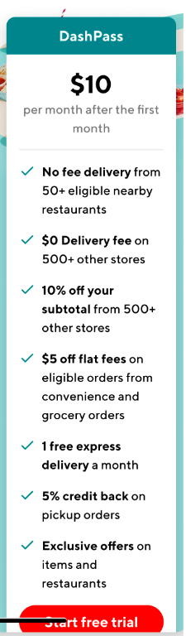
Clarifying & punching up exclusive member benefits could help expand value gap beyond selection
Most Cx quickly understand that DashPass opens up to a wider range of non-nearby stores and felt that was a clear value add for DashPass
The majority of Cx were drawn to language around Member Exclusive offers, however, they have mixed feelings about it
They like the idea of exclusivity, but do not trust that is the case
They want quantification of offers to include in their “mental math”
These benefits need to feel personalized to them and easy to find

Slide 20
NON-DASHPASS USERS
Member exclusive features are rated appealing among potential DashPass users
Appeal of DashPass Exclusive Features
% T2B Among Non-DashPass Users
Exclusive Savings | % T2B | Exclusive Perks | % T2B | Exclusive Services | % T2B
Free Daily Items | 77% | Exclusive Menu Items | 68% | Dine-In | 64%
Food Item Combos | 69% | Exclusive Merchants | 58% | Nationwide Shipping | 58%
Punch Cards | 66% | Exclusive Events | 53% | Package Pickup | 58%
Spend More, Save More | 63% | Celebrity Partnerships | 38% | DashMart | 52%
 |  |  |  | Meal Plans | 52%
 |  |  |  | Meal Kit | 52%
 |  |  |  | Priority Dining Reservations | 51%
DashPass Benefits Conjoint
Base: Non-DashPass Users n=1,015
Q5. DashPass members could also get exclusive offers for additional savings. How appealing is each of the following potential exclusive promotional offers that could be available? Q6. DashPass members could also get access to exclusive perks. How appealing is each of the following potential exclusive perks that could be available? Q7. DashPass subscribers could also get access to exclusive services that are only available to subscribers.

Slide 21
However, Cx still struggle to weigh the pros and cons; the math needs to be easier
“
“
I like the member exclusive offers, I like the potential that I will get better deals. That’s the big thing that catches my eye”
Personally I don’t know if that does anything for me (Member Exclusives) because the app already highlights that. It doesn’t feel like I’m getting anything extra or special”
“
The increase in the number of stores is the obvious thing, that makes it more”
“
I would consider how many restaurants are participating, sometimes you sign up for it will cost most Rx I want, and if it doesn’t end up covering all the restaurants then its a turn off and I think maybe I don’t need it then”
“
I think paying the $10 may actually end up being a little better because you a whole lot of variety instead of a small variety”

Slide 22
Insight summary…
It is very difficult for Cx to learn about DashPass in app today, most Cx recall information about DashPass from banners
While once a week is the minimum frequency where DashPass feels viable, 2-3 orders per week feels safer.
Member exclusive offers are the most eye catching benefit for Nearby Cx, however they need reassurance that these offers are received regularly and are truly exclusive
Some Cx feel they would benefit from a longer trial to recognize value and learn about DashPass benefits

Slide 23
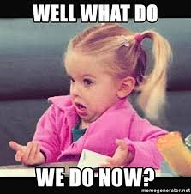
So…what can we do?

Slide 24
A few thoughts based on what we’ve learned so far…
We could target the lowest hanging fruit Nearby Cx (those with 2-3 orders per week or at least once a month) with communications around the potential weekly savings they will receive
Right now in-app communications are planned at a “journey level”. We could work with the DashPass team to ensure that DashPass banners (which are most recalled by Cx) are shown in complementary experiences with Nearby or DashPass Lite carousel communications.
We could experiment with a 60 day DashPass trial after your X# nearby purchase
We should would with our DashPass partners to quantify or clarify member exclusive offers and test as a cart upsell benefit
We can work with the personalization team to push Cx towards MxShift

Slide 25
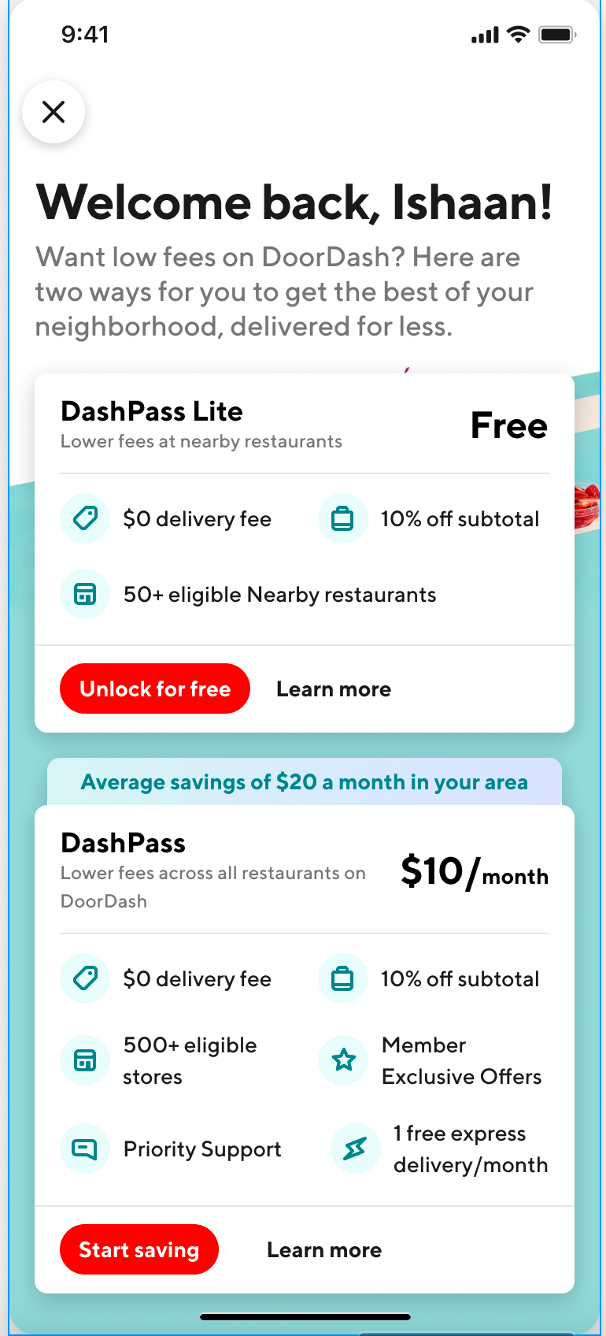
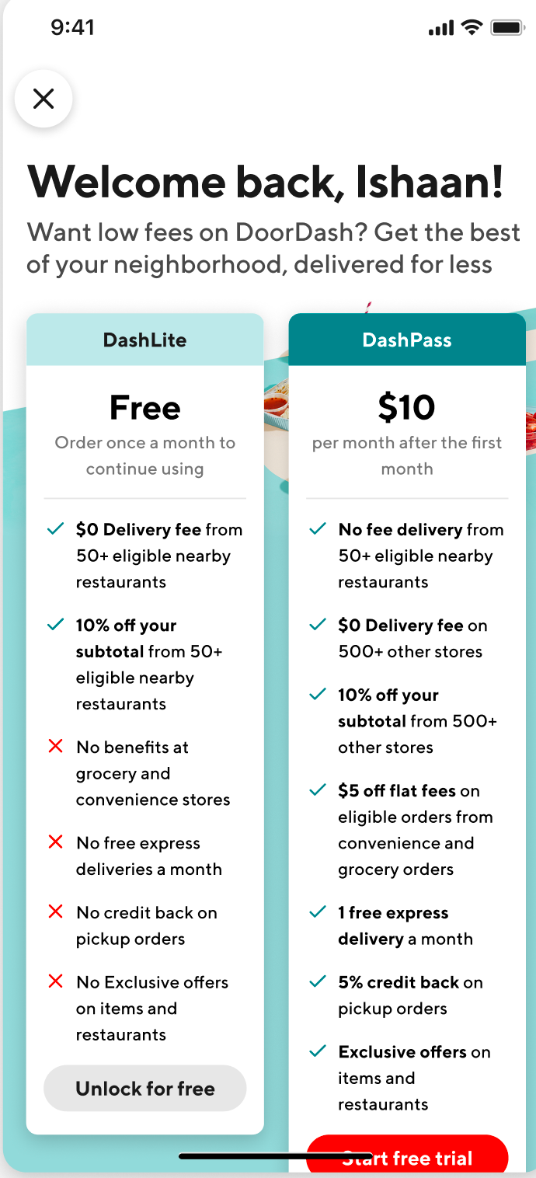


We must continue to explore DashPass lite, taking into account Cx feedback
Cx liked the idea of Nearby $0 delivery for DashPass lite
Cx who like to compare across apps felt the 10% helped DashPass Lite stay competitive with other offers/discounts available
Some Cx though that DashPass Lite was another version of the free trial and they would eventually be charged for DashPass
Some Cx were concerned that there would be too much Mx overlap (e.g. the 3 Wendy’s in my area would count towards 3 of the Nearby Mx)
UXR recommends further concept testing and A/B research testing rotation vs. consistent set of Rx

Slide 26






Never forget affordability=
cost/value
Top value levers for Cx:
Cx are looking for value, how can we build this into our DashPass levers?
Time saved
“
Energy saved
“It’s 0.99 cents but on DoorDash it’s $4.50. Why is it so much more? It’s an extra charge that I don’t like. What am I getting for that?”
Selection of cuisines
“
“We wanted to eat out less and eat healthier at home. Noticed that there are unhealthy restaurants and it’s expensive; we're trying to review what’s healthier and cheaper.”
Food quality/Taste
Timeliness of delivery
“
Feeding the whole family
“I want to pay as little as possible, but I also want it to be fair”

Slide 27
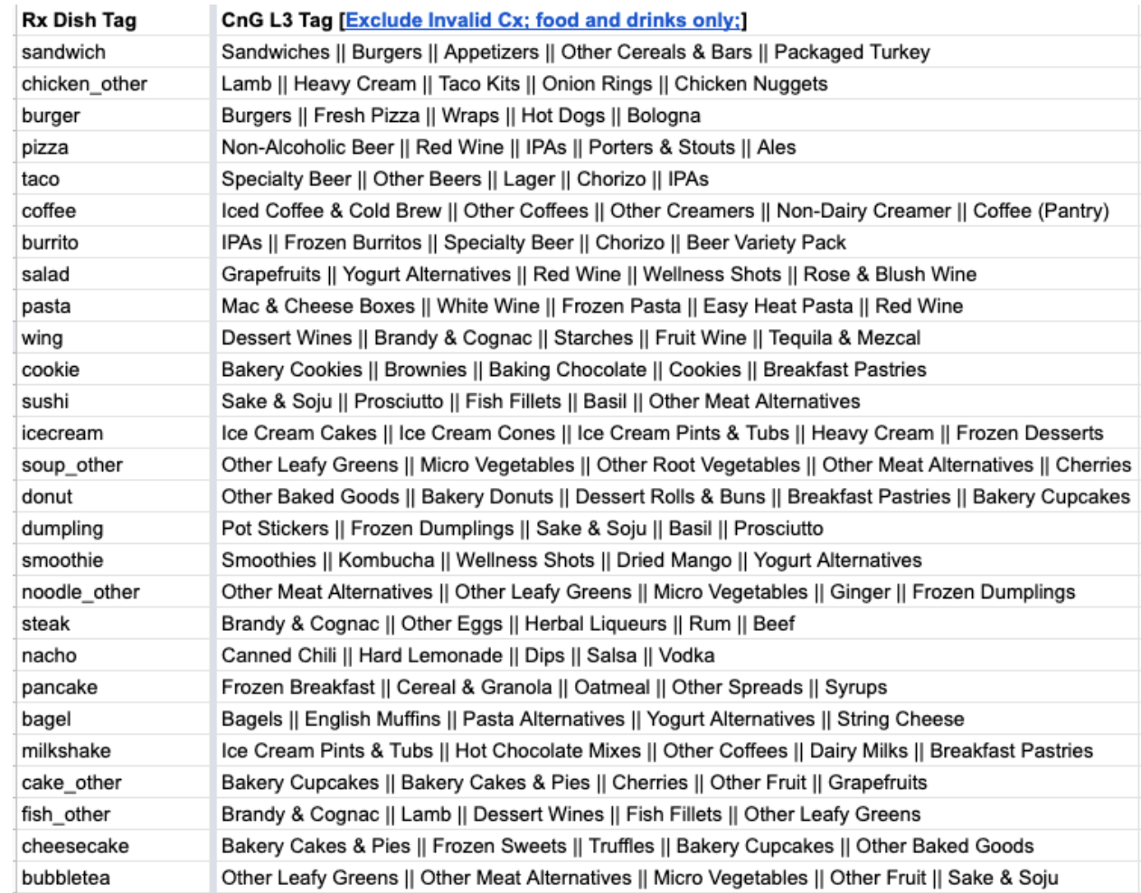
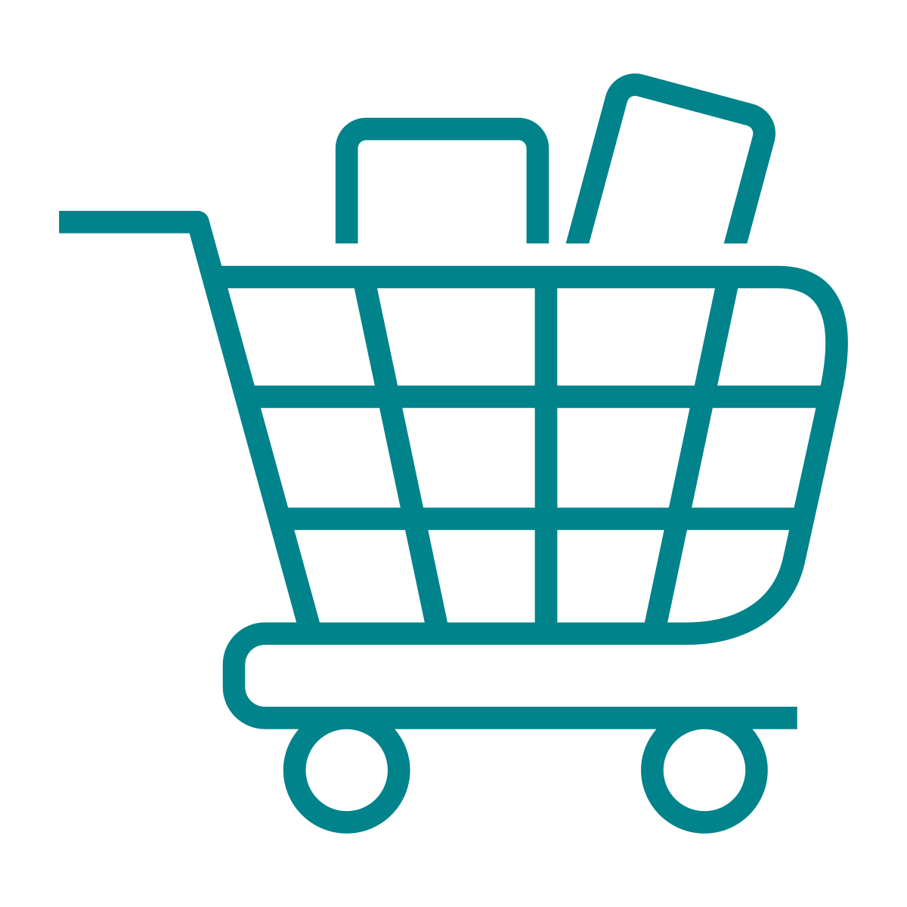
We can tackle value by continuing to chip away at non-affordability reasons for occasional Cx churn
New analysis can even help us to target specific grocery items they may need based on the restaurants they order from
Of occasional Cx churned from DoorDash because they cook more regularly at home
21%
What if we highlight DashPass’s grocery benefits for “holdouts” (Cx who do not increase order frequency after a few months of Nearby exposure)
See details here

Slide 28

Longer term opportunity around quality
Quality and Lateness have overtaken Fees as the top drivers of negative sentiment in recent NPS analysis
Of occasional Cx churned because they were facing frequent issues with their delivery
12%
Of occasional Cx churned because customer support did not meet their expectations
6%
What if we work more closely with CS and the DashPass team to educate on any new quality initiatives in Nearby instances where issues occur
Q4 2022 NPS

Slide 29
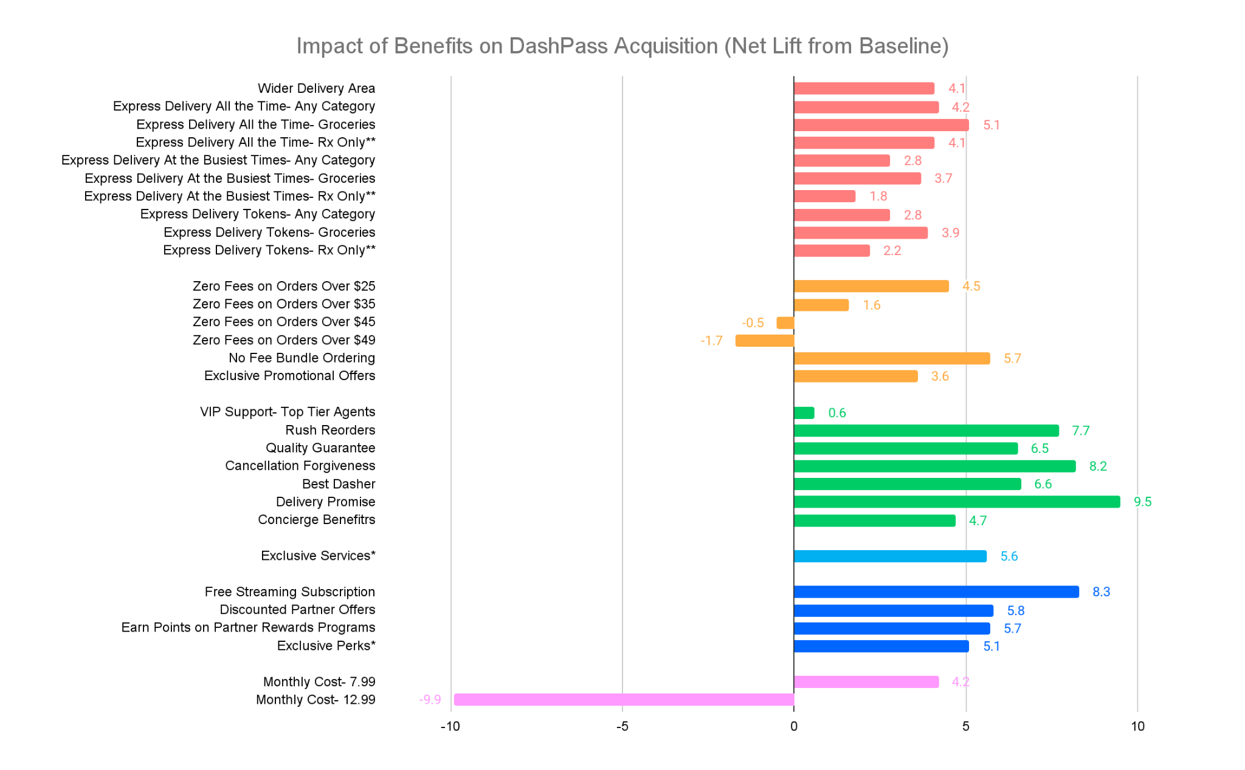
Quality benefits can have the greatest impact on DP acquisition.
The single most impactful features are:
Delivery Promise (+9.5)
Free Streaming Subscription (+8.3)
Cancellation Forgiveness (+8.2)
Rush Reorders (+7.7)
Best Dasher (+6.6)
Quality Guarantee (+6.5)
Satisfaction with delivery experiences is the basis for signing up for DashPass
PRICE PARTNERSHIPS QUALITY AFFORDABILITY DELIVERY
DashPass Benefits Conjoint
Base: Non-DashPass Users n=1,015
Discrete Choice Results (modelling one benefit at a time)
If the DashPass option you selected above were available, how likely would you be to actually subscribe to it?
* See later section for which specific exclusive services and perks were most attractive.
** Rx Only was the default/unspecified. The respondent only saw nothing/blank, “all categories” or “groceries”

Slide 30

Thoughts or questions?
What else would you like to know?

Slide 31
Upcoming research this month
IMPACT OF BATCHING ON NEARBY
ACROSS APP COMPARISON
We will run a quant/qual combo study alongside our upcoming batching experiments to identify if Cx perceive any decrease in timeliness and quality. Results expected in next readout meeting.
This 2 phase study will quantify the most important factors Cx consider when comparing across apps and the where they look for these factors. Results expected mid April.

Slide 32
Let’s go!

